Slide 1

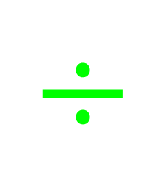







My Number Interactive Notebook
$$×$$
$$\frac{1}{2}$$
$$÷$$
$$+$$
$$−$$
$$\frac{3}{5}$$
$$7$$
Name
Class
Teacher
Term 1 Semester 1
$$5^{2}$$
$$\sqrt{9}$$
1

Slide 2
Create your own front page
It needs to contain the following –
My number interactive notebook
Name
Class
Teachers Name
Semester 1 Term 1
Page number 1

Slide 3
Contents
Glossary or Formula Page
Page
Date
Description
2
3

Slide 4
Tasks
24
7
30
Essential Question
Questions
Notes
Summary
8
9

Slide 5
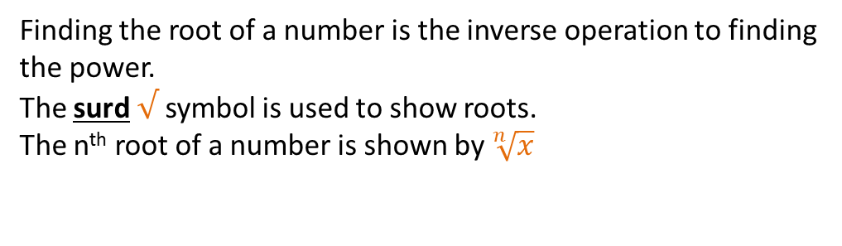
24
7
30
Date
Roots
EQ – How are fractional indices related to roots?
What is the nth root?
Finding the root of a number is the inverse operation to finding the power.
The surd $√$ symbol is used to show roots.
The n^{th} root of a number is shown by $\sqrt[n]{x}$
9

Slide 6
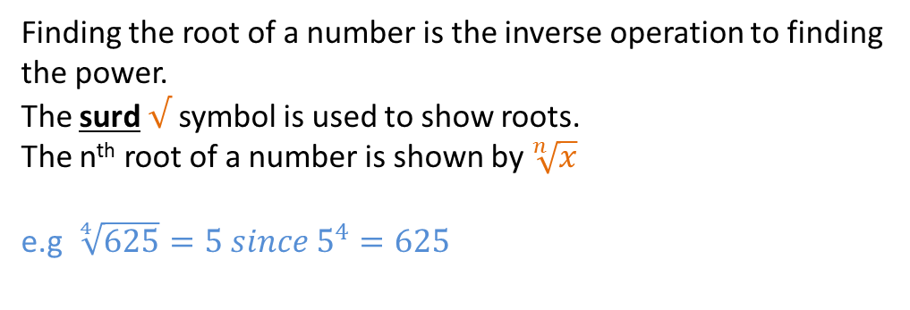
24
7
30
Date
Roots
EQ – How are fractional indices related to roots?
What is the nth root?
Finding the root of a number is the inverse operation to finding the power.
The surd $√$ symbol is used to show roots.
The n^{th} root of a number is shown by $\sqrt[n]{x}$
e.g $\sqrt[4]{625}=5 since 5^{4}=625$
9

Slide 7
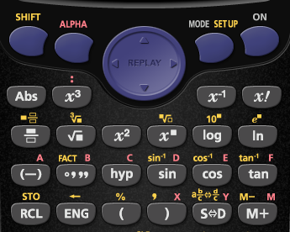
How do I find on a calculator?
Root button
Power button

Slide 8

24
7
30
Date
Roots
EQ – How are fractional indices related to roots?
What is the nth root?
Finding the root of a number is the inverse operation to finding the power.
The surd $√$ symbol is used to show roots.
The n^{th} root of a number is shown by $\sqrt[n]{x}$
e.g $\sqrt[4]{625}=5 since 5^{4}=625$
How is the square root written in index notation?
$$\sqrt{x^{2}}=x$$
5

Slide 9

24
7
30
Date
Roots
EQ – How are fractional indices related to roots?
What is the nth root?
Finding the root of a number is the inverse operation to finding the power.
The surd $√$ symbol is used to show roots.
The n^{th} root of a number is shown by $\sqrt[n]{x}$
e.g $\sqrt[4]{625}=5 since 5^{4}=625$
How is the square root written in index notation?
$$\sqrt{x^{2}}=x^{1}$$
5

Slide 10
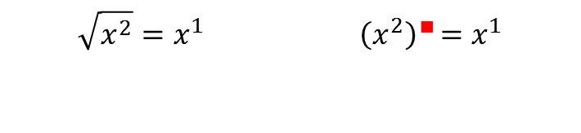
24
7
30
Date
Roots
EQ – How are fractional indices related to roots?
What is the nth root?
Finding the root of a number is the inverse operation to finding the power.
The surd $√$ symbol is used to show roots.
The n^{th} root of a number is shown by $\sqrt[n]{x}$
e.g $\sqrt[4]{625}=5 since 5^{4}=625$
How is the square root written in index notation?
$$\sqrt{x^{2}}=x^{1}{ \left(x^{2}\right)}^{∎}=x^{1}$$
5

Slide 11
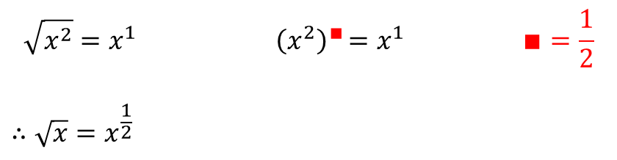
24
7
30
Date
Roots
EQ – How are fractional indices related to roots?
What is the nth root?
Finding the root of a number is the inverse operation to finding the power.
The surd $√$ symbol is used to show roots.
The n^{th} root of a number is shown by $\sqrt[n]{x}$
e.g $\sqrt[4]{625}=5 since 5^{4}=625$
How is the square root written in index notation?
$$\sqrt{x^{2}}=x^{1}{ \left(x^{2}\right)}^{∎}=x^{1} ∎=\frac{1}{2}$$
$$∴\sqrt{x}=x^{\frac{1}{2}}$$
5

Slide 12
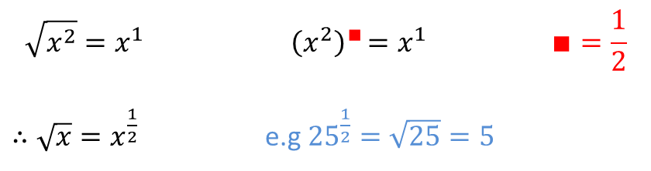

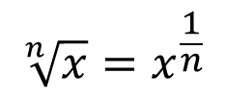
24
7
30
Date
Roots
EQ – How are fractional indices related to roots?
What is the nth root?
Finding the root of a number is the inverse operation to finding the power.
The surd $√$ symbol is used to show roots.
The n^{th} root of a number is shown by $\sqrt[n]{x}$
e.g $\sqrt[4]{625}=5 since 5^{4}=625$
How is the square root written in index notation?
$$\sqrt{x^{2}}=x^{1}{ \left(x^{2}\right)}^{∎}=x^{1} ∎=\frac{1}{2}$$
$∴\sqrt{x}=x^{\frac{1}{2}}$ e.g ${25}^{\frac{1}{2}}=\sqrt{25}=5$
How is the n^{th} root written in index notation?
$$\sqrt[n]{x}=x^{\frac{1}{n}}$$
e.g ${625}^{\frac{1}{4}}=\sqrt[4]{625}=5$
5

Slide 13
24
7
30
Date
Roots
EQ – How are fractional indices related to roots?
What is the nth root?
Finding the root of a number is the inverse operation to finding the power.
The surd $√$ symbol is used to show roots.
The n^{th} root of a number is shown by $\sqrt[n]{x}$
e.g $\sqrt[4]{625}=5 since 5^{4}=625$
How is the square root written in index notation?
$$\sqrt{x^{2}}=x^{1}{ \left(x^{2}\right)}^{∎}=x^{1} ∎=\frac{1}{2}$$
$∴\sqrt{x}=x^{\frac{1}{2}}$ e.g ${25}^{\frac{1}{2}}=\sqrt{25}=5$
How is the n^{th} root written in index notation?
5

Slide 14
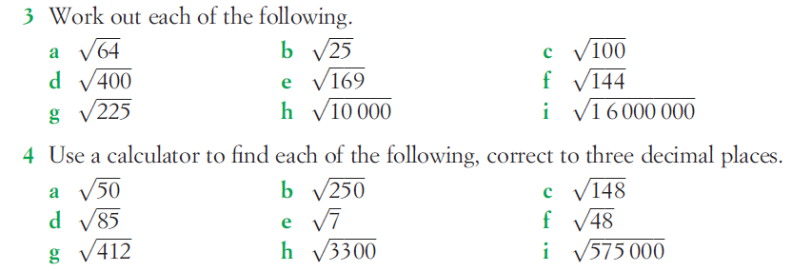
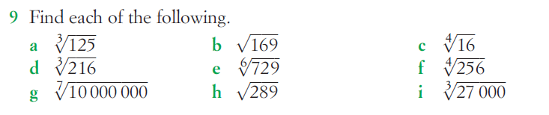
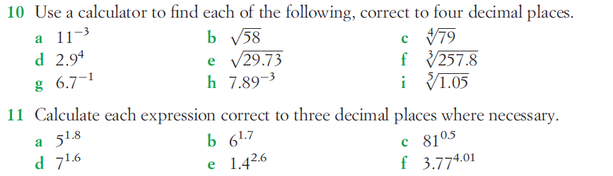

Slide 15
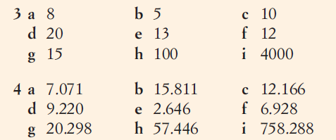
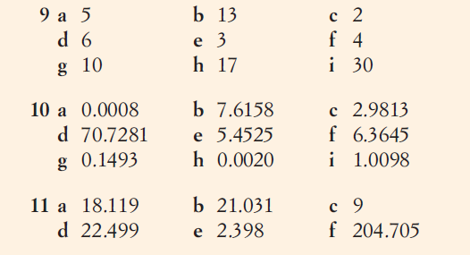
Answers

Slide 16
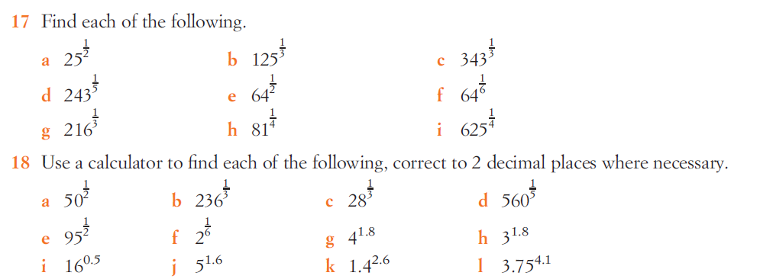

Slide 17
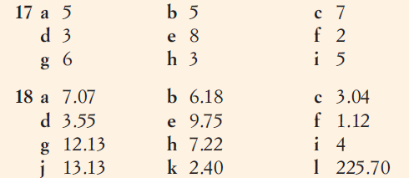
Answers

Slide 18
Notes Review
24, 7 ,30
Date
Title
Essential question
Notes complete
Notes complete with colour and diagrams
Questions completed
Contents page filed in
Formula page filled in

Slide 19
Homework
Review your notes and write a summary answering the essential question.

